Slide 1

21CSL55- Database Management System
Subject: Database Management System
Semester : V
Course Instructor: Ch.Manasa
Department of Information Science and Engineering, CMRIT – Bangalore.
Email Id: manasa.c@cmrit.ac.in
Phone: 8790336066

Slide 2
DBMS - Module 3
SQL :
Advances Queries: More complex SQL retrieval queries, Specifying constraints as assertions and action triggers, Views in SQL, Schema change statements in SQL.
Database Application Development: Accessing databases from applications, An introduction to JDBC, JDBC classes and interfaces, SQLJ, Stored procedures, Case study: The internet Bookshop.
Internet Applications: The three-Tier application architecture, The presentation layer, The Middle Tier

Slide 3
Recall the Basic SQL Terms to learn more complex SQL Queries
DDL Statement
DML Statement
TCL
DDL
SQL Select Statement

Slide 4
1.More Complex SQL Retrieval Queries
Comparisons Involving NULL and Three-Valued Logic
Nested Queries, Tuples, and Set/Multiset Comparisons
Correlated Nested Queries
The EXISTS and UNIQUE Functions in SQL
Explicit Sets and Renaming of Attributes in SQL
Joined Tables in SQL and Outer Joins
Aggregate Functions in SQL
Grouping: The GROUP BY and HAVING Clauses

Slide 5
More Complex SQL Retrieval Queries-Introduction
DBMS allow users to specify more complex retrievals from database:
  Nested queries
  Joined tables
  Outer joins
  Aggregate functions and
  Grouping

Slide 6
Single Row Sub Query: Sub query which returns single row output. They mark the usage of single row comparison operators, when used in WHERE conditions.
SQL> select first_name, salary, department_id from employees
where salary = (select min(salary) from employees);
In this SELECT query, inner SQL returns only one row i.e. the minimum salary for the company. It in turn uses this value to compare salary of all the employees and displays only those, whose salary is equal to minimum salary.
SQL>select department_id, min(salary) from employees department_id having min(salary) < (select avg(salary) from employees Group by department);
  A HAVING clause is used when the group results of a query need to be restricted based on some condition. If a subquery's result must be compared with a group function, you must nest the inner query in the outer query's HAVING clause

Slide 7
Multiple row sub query: Sub query returning multiple row output. They make use of multiple row comparison operators like IN, ANY, ALL. There can be sub queries returning multiple columns also.
Multiple-row subqueries are nested queries that can return more than one row of results to the parent query. Multiple-row subqueries are used most commonly in WHERE and HAVING clauses. Since it returns multiple rows, it must be handled by set comparison operators (IN, ALL, ANY)
SQL> select first_name, department_id from employees where
Department_id=(select department_id from employees where location_id=100); // error in query
SQL> select first_name, department_id from employees where
Department_id in (select department_id from departments where location_id=100);

Slide 8
Multiple column sub query
A multiple-column subquery returns more than one column to the outer query and can be listed in the outer query's FROM, WHERE, or HAVING clause. For example, the below query shows the employee's historical details for the ones whose current salary is in range of 1000 and 2000 and working in department 10 or 20.
SQL> select first_name, job_id, salary from emp_history where (salary, department_id) in (select salary, department_id from employees where salary between 1000 and 2000 and Department_id between 10 and 20);

Slide 9
Correlated Sub Query: Correlated subqueries depend on data provided by the outer query. This type of subquery also includes subqueries that use the EXISTS operator to test the existence of data rows satisfying specified criteria.
As reverse to a regular subquery, where the outer query depends on values provided by the inner query, a correlated subquery is one where the inner query depends on values provided by the outer query. This means that in a correlated subquery, the inner query is executed repeatedly, once for each row that might be selected by the outer query
SQL> select employee_id, salary, department_id from employees E
where salary >(select avg(salary) from Emp T where
E.department_id=T.department_id);

Slide 10
Nested Sub Query
Example
“Find all customers who have both an account and a loan at bank.”
SQL> select distinct customer_name from borrower
where customer_name in (select customer_name from depositor);
Eg., 2
“Find all customers who have a loan at the bank but do not have an account at the bank.”
SQL> select distinct customer-name from borrower
where customer_name not in (select customer_name from depositor)

Slide 11
“Find all customers who have both an account and a loan at the Perryridge branch.”
SQL> select distinct customer-name from borrower, loan
where borrower.loan_number = loan.loan_number and
branch-name = “Perryridge” and (branch_name, custome_name) in (select branch-name, customer-name from depositor, account where depositor.account_number = account.account-number);

Slide 12
Set Comparison
“Find all branches that have greater assets than some branch located in Brooklyn”
SQL> select distinct T.branch-name from branch as T, branch as S
where T.assets > S.assets and S.branch-city = “Brooklyn”;
The SOME clause
F <comp> some r ⇔ ∃ t(t ∈ r∧ [F <some> t]) Where <some> can be: <, <=, >, >=, = and !=

Slide 13




(5 < Some ) = true - - (read: 5 < some tuple in the relation)
(5 < Some ) = false
(5 = Some ) = true
(5 not some ) = true (since 0 not some 5)

Slide 14


some
“Find all branches that have greater assets than some branch located in ‘Brooklyn’.
SQL> select branch_name from branch
where assets>some (select assets from branch where
branch_city’=“Brooklyn”);
All Clause
F <comp> all r ⇔ ∀ t (t ∈ r ∧ [F<comp> t])
(5 < all ) =false * (5 < all )

Slide 15


(5=all ) = false
(5 not = all ) = true ( since 5 !=4 and 5!=6)
• (!= all) ≡ not in
However, (= all) !≡ in
Example: “Find the names of all branches that have greater assets than all the branches located in ‘Brooklyn’;
SQL> select branch_name from branch where assets > all (select assets from branch where branch_city=‘Brooklyn’);

Slide 16
Test for Empty Relation
The exists construct returns the value true if the argument subquery is nonempty.
exists r ⇔ r != ∅
not exists r ⇔ r = ∅
Example:
“Find all customers who have an account at all branches located in ‘Brooklyn’”.
SQL> select distinct S.customer_name from depositor as S where not exists ( select branch_name from branch where branch_city=“Brooklyn”)
except (select R.branch_name from depositor as T, account as R
where T.account_number=R.account_number and S.customer_name=T.customer_name);

Slide 17
Comparisons Involving NULL and Three-Valued Logic
SQL has various rules for dealing with NULL values.
NULL is used to represent a missing value
Meanings of NULL
  Unknown value
  Unavailable or withheld value
  Not applicable attribute

Slide 18
Aggregate Function – Having Clause
“Find the names of all branches where the average account balance is more than 1200”
SQL> select branch_name, avg(balance)
from account
group by branch_name
having avg(balance)>1200;
Note: predicate in the having class applied after the formation of groups

Slide 19
  Unknown value- (exists but is not known)
  Unavailable or withheld value
  (exists but is purposely withheld),
  Not applicable attribute(the attribute is undefined for this tuple).

Slide 20
Consider the following examples to illustrate each of the meanings of NULL.
Unknown value. A person’s date of birth is not known, so it is represented by NULL in the database.
Unavailable or withheld value. A person has a home phone but does not want it to be listed, so it is withheld and represented as NULL in the database.
Not applicable attribute. An attribute LastCollegeDegree would be NULL for a person who has no college degrees because it does not apply to that person.
Each individual NULL value considered to be different from every other NULL value
SQL uses a three-valued logic:
  TRUE, FALSE, and UNKNOWN

Slide 21
In general, each individual NULL value is considered to be different from every other NULL value in the various database records.
When a NULL is involved in a comparison operation, the result is considered to be UNKNOWN (it may be TRUE or it may be FALSE).
Hence, SQL uses a three-valued logic with values TRUE, FALSE, and UNKNOWN instead of the standard two-valued (Boolean) logic with values TRUE or FALSE.
It is therefore necessary to define the results (or truth values) of three-valued logical expressions when the logical connectives AND, OR, and NOT are used.

Slide 22
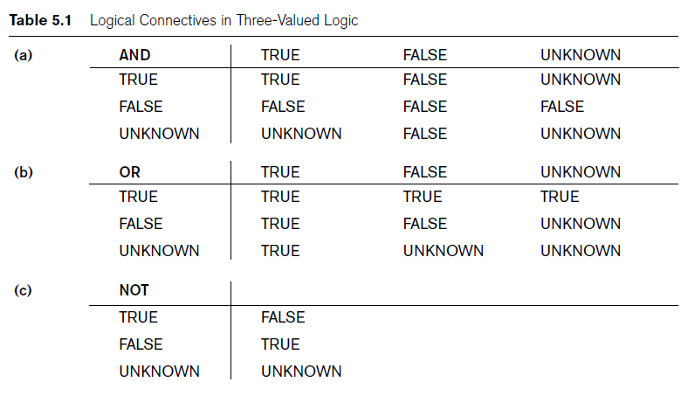
Comparisons Involving NULL and Three-Valued Logic (cont’d.)

Slide 23
SQL allows queries that check whether an attribute value is NULL
  IS or IS NOT NULL
  Query. Retrieve the names of all employees who do not have supervisors.
  SELECT Fname, Lname
  FROM EMPLOYEE
  WHERE Super_ssn IS NULL;

Slide 24
Some queries require that existing values in the database be fetched and then used in a comparison condition.
Such queries can be conveniently formulated by using nested queries, which are complete select-from-where blocks within the WHERE clause of another query.
That other query is called the outer query.
Nested queries
  Complete select-from-where blocks within WHERE clause of another query

Slide 25
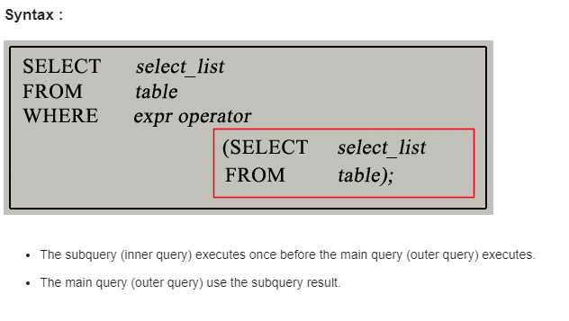
Nested query

Slide 26
IN operator which is a comparison operator that compares a value v with a set (or multiset) of values V and evaluates to TRUE if v is one of the elements in V.
Ex: Query
Retrieve the Social Security numbers of all employees who work on project numbers 1,2,or 3.
Answer:
SELECT DISTINCT Essn FROM WORKS_ON WHERE Pno IN (1, 2, 3);

Slide 27
SQL allows the use of tuples of values in comparisons by placing them within parentheses.
To illustrate this, consider the following query:
SELECT DISTINCT Essn FROM WORKS_ON WHERE (Pno, Hours) IN ( SELECT Pno, Hours FROM WORKS_ON WHERE Essn=‘123456789’);
This query will select the Essns of all employees who work the same (project,hours) combination on some project that employee ‘John Smith’ (whose Ssn = ‘123456789’) works on.
In this example, the IN operator compares the subtuple of values in parentheses (Pno, Hours) within each tuple in WORKS_ON with the set of type-compatible tuples produced by the nested query.

Slide 28
In addition to the IN operator ,a number of other comparison operators can be used to compare a single value v (typically an attribute name) to a set or multiset v (typically a nested query).
The = ANY (or = SOME) operator returns TRUE if the value v is equal to some value in the set V and is hence equivalent to IN.
The two keywords ANY and SOME have the same effect. Other operators that can be combined with ANY (or SOME) include >, >=, <, <=, and <>.
The keyword ALL can also be combined with each of these operators.
For example, the comparison condition (v>ALL V) returns TRUE if the value v is greater than all the values in the set (or multiset) V.

Slide 29
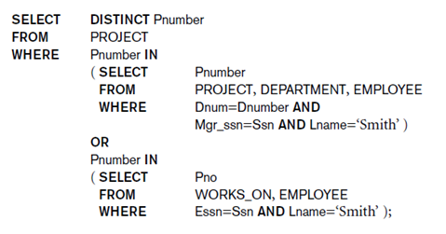

Slide 30
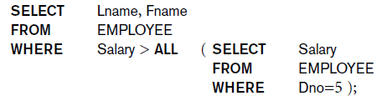
Update Operations, Transactions, and
Dealing with Constraint Violations
Use other comparison operators to compare a single value v
  = ANY (or = SOME) operator
    Returns TRUE if the value v is equal to some value in the set V and is hence equivalent to IN
  Other operators that can be combined with ANY (or SOME): >, >=, <, <=, and <>

Slide 31
Avoid potential errors and ambiguities
  Create tuple variables (aliases) for all tables referenced in SQL query
  Retrieve the name of each employee who has a dependent with the same first name and is the same sex as the employee.
  SELECT E.Fname, E.Lname
  FROM EMPLOYEE AS E
  WHERE E.Ssn IN ( SELECT D.Essn
  FROM DEPENDENT AS D
  WHERE E.Fname = D.Dependent_name
  AND E.Sex = D.Sex );

Slide 32
Correlated nested query
  Whenever a condition in the WHERE clause of a nested query references some attribute of a relation declared in the outer query, the two queries are said to be correlated.
  We can understand a correlated query better by considering that the nested query is evaluated once for each tuple (or combination of tuples) in the outer query.

Slide 33
For each EMPLOYEE tuple ,evaluate the nested query ,which retrieves the ESSN values for all DEPENDENTS tuples with the same sex and name as that EMPLOYEE tuple ;if the ssn of the employee tuple is in the result of the nested query ,then select that EMPLOYEE table.
Retrieve the name of each employee who has a dependent with the same first name and is the same sex as the employee.
Select E.Fname,E.Lname from EMPLOYEE AS E ,DEPENDENT AS D where E.Ssn=D.Essn AND E.Sex =D.Sex AND E.Fname =D.dependent_ name;

Slide 34
EXISTS and UNIQUE are Boolean function that returns TRUE or FALSE.
EXISTS function
  Check whether the result of a nested query is empty (Contains no tuple)or not
  The result of EXISTS is a boolean value TRUE if the nested query contains at least one tuple or FALSE if the nested query contains no tuples.
EXISTS and NOT EXISTS
  Typically used in conjunction with a correlated nested query
SQL function UNIQUE(Q)
  Returns TRUE if there are no duplicate tuples in the result of query Q. Otherwise it returns false

Slide 35
  Retrieve the name of each employee who has a dependent with the
  same first name and is the same sex as the employee.
Select E.Fname,E.Lname from EMPLOYEE AS E
where EXISTS
(Select * from DEPENEDENT AS D
where E.Ssn=D.Essn AND E.Sex =D.Sex AND E.Fname =D.dependent_ name);

Slide 36
Retrieve the name of employees who have no dependents.
Select Fname, Lname from Employee where NOT EXISTS (Select * from DEPENEDENT where Ssn=Essn);
List the names of managers who have at least one dependent.
SELECT Fname,Lname FROM Employee WHERE EXISTS (SELECT * FROM DEPENEDENT WHERE Ssn=Essn) AND EXISTS (SELECT * FROM DEPARTMENT WHERE Ssn=Mgr_ssn);
Retrieve the name of each employee who works on all project controlled by department no 5.
Select Fname, Lname FROM EMPLOYEE WHERE NOT EXISTS ((Select Pnumber FROM PROJECT WHERE Dnum=5) EXCEPT (select Pno FROM Works_on WHERE Ssn=Essn));

Slide 40
Find the names of all customers who have loan at the bank and find the amount of the loan;
Find the names of all branches with customer who have an account in the bank and who lives in “Harrison”.
Division Operation
Find all customer who have an account at all the branches located in ‘Brooklyn’.
Aggregate Function
> Find the average account balance at the ‘Perryridge’ branch.
> Find the averseleage account balance at each branch.
> Find the No. of depositor for each branch.
> Find the branches where the average account balance is more than 1200
> Find the average balance for each customer who lives in “Harrison” and has at least three account

Slide 41
Nested Queries
Find all customers who have both a loan and an account.
Find all customers who have both an account and a loan at the ‘Perryridge’ branch.
Find all customer who do have a loan at the bank, but do not have an account at the bank.
Select names of customer who have a loan at the bank and where names are neither “Smith” nor “Jones”.
Find the names of all the branches that have assets greater than those of at least one branch located in “Brooklyn”
Find the branch that has the highest average balance.

Slide 42
dept name =“Physics” (instructor )
We can find all instructors with salary greater than $90,000 by writing:
salary>90000 (instructor)
The Project Operation
The project operation is a unary operation that returns its argument relation, with certain attributes left out.
Suppose we want to list all instructors’ ID, name, and salary, but do not care about the dept name. Projection is denoted by the uppercase Greek letter pi (π)
The result is defined as the relation of k columns obtained by erasing the columns that are not listed
Duplicate rows removed from result, since relations are sets
Example
π ID, name, salary (instructor )

Slide 43
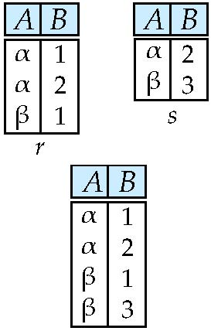
The Union Operation
Relations r, s:
r ∪ s:

Slide 44
Example
To find the set of all courses taught in the Fall 2009 semester, we
write:
π course id (semester =“Fall”∧ year=2009 (section))
To find the set of all courses taught in the Spring 2010 semester, we write:
π course id (semester =“Spring”∧year=2010 (section))
To answer the query, we need the union of these two sets; that is, we need all section IDs that appear in either or both of the two relations. We find these data binary operation union, denoted, as in set theory, by ∪. So the expression
needed is:
course id (semester =“Fall”∧ year=2009 (section)) ∪ course id (semester =“Spring” ∧ year=2010 (section))

Slide 45
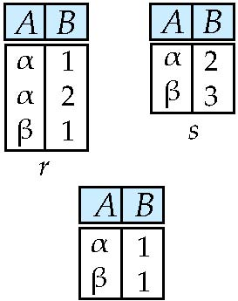
Set difference of two relations
Relations r, s:
r – s

Slide 46
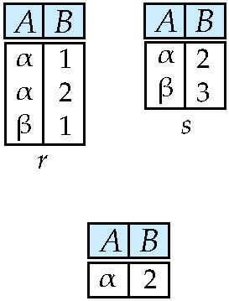
Set intersection of two relations
Relation r, s:
r ∩ s
Note: r ∩ s = r – (r – s)

Slide 47
Thus, to select those tuples of the loan relation where the branch is “Perryridge,” we write
SQL>σ branch-name = “Perryridge” (loan)
We can find all tuples in which the amount lent is more than $1200 by writing
SQL>σ amount>1200 (loan)
find those tuples pertaining to loans of more than $1200 made by the Perryridge branch, we write
SQL> σ branch-name = “Perryridge” ∧ amount>1200 (loan)
The Project Operation
we write the query to list all loan numbers and the amount of the loan as
SQL>Π loan-number, amount(loan)

Slide 48
Composition of Relational Operations
The fact that the result of a relational operation is itself a relation is important. Consider the more complicated query “Find those customers who live in Harrison.” We write:
SQL> Π customer-name (σ customer-city = “Harrison” (customer ))
The Union Operation
how to find the names of all customers with a loan in the bank
SQL> Π customer-name (borrower)
and
SQL> Πcustomer-name (depositor)
SQL> Πcustomer-name (borrower ) ∪ Πcustomer-name (depositor)

Slide 49
The Set Difference Operation
find all customers of the bank who have an account but not a loan
SQL> Πcustomer-name (depositor) − Πcustomer-name (borrower)

Slide 50
The following command creates a relation department in the database.
create table department (dept name varchar (20), building varchar (15), budget numeric (12,2), primary key (dept name));
Queries: “Find the names of all instructors.”
The instructor’s name appears in the name attribute, so we put that in the select clause.
select name from instructor;
Example query: “Find the department names of all instructors,”
select dept name from instructor ;

Slide 51
The select clause is used to list the attributes desired in the result of a query.
• The from clause is a list of the relations to be accessed in the evaluation of the query.
• The where clause is a predicate involving attributes of the relation in the from clause.
A typical SQL query has the form
select A1, A2, . . . , An
from r1, r2, . . . , rm
where P;

Slide 52
Aggregate Functions
Aggregate functions are functions that take a collection (a set or multiset) of values as input and return a single value. SQL offers five built-in aggregate functions:
• Average: avg
• Minimum: min
• Maximum: max
• Total: sum
• Count: count
Basic Aggregation
Consider the query “Find the average salary of instructors in the Computer Science department.” We write this query as follows:
select avg (salary) from instructor where dept name= ’Comp. Sci.’;

Slide 53
An example arises in the query “Find the total number of instructors who teach a course in the Spring 2010 semester.”
select count (distinct ID)
from teaches where semester = ’Spring’ and year = 2010;
consider the query “Find the average salary in each department.” We write this query as follows:
select dept name, avg (salary) as avg salary
from instructor group by dept name;
consider the query “Find the average salary of all instructors.” We write this query as follows:
select avg (salary) from instructor;

Slide 54
Referential Integrity
USN (PK) | Name | DOB | Address | Phone
1mj18is1 | Abc | 12 | Dfkdj | 12541
1mj18is2 | Def | 12 | Doierj | 13256
1mj18is3 | ghi | 21 | xxcns | 65238
Sport No | S_name | USN | Name | Date
100 | X | 1mj18is1 | Abc
200 | Y | 1mj18is2 | Def
300 | z | 1mj18is3 | ghi

Slide 55
Relational database design using ER-to-relational mapping
Entity-Relationship Model. The entity-relationship (E-R) data model uses a collection of basic objects, called entities, and relationships among these objects. An entity is a “thing” or “object” in the real world that is distinguishable from other objects. The entity-relationship model is widely used in database design.
The entity-relationship (E-R) data model was developed to facilitate database design by allowing specification of an enterprise schema that represents the overall logical structure of a database.
The E-R model is very useful in mapping the meanings and interactions of real-world enterprises onto a conceptual schema.
The E-R data model employs three basic concepts: entity sets, relationship sets, and attributes.

Slide 56
Relationship Sets
A relationship is an association among several entities. For example, we can define a relationship advisor that associates instructor Katz with student Shankar. This relationship specifies that Katz is an advisor to student Shankar.
relationship set is a set of relationships of the same type. Formally, it is a mathematical relation on n ≥ 2 (possibly nondistinct) entity sets. If E1, E2, . . . , En. are entity sets, then a relationship set R is a subset of
{(e1, e2, . . . , en) | e1 ∈ E1, e2 ∈ E2, . . . , en ∈ En}
where (e1, e2, . . . , en) is a relationship.
Attributes: For each attribute, there is a set of permitted values, called the domain, or value set, of that attribute.
attribute types are:
Simple and composite attributes.
Single-valued and multivalued
Derived attribute.

Slide 57
SQL: Data definition and data types
Integrity Constraints: Integrity constraints ensure that changes made to the database by authorized users do not result in a loss of data consistency.
Examples of integrity constraints are:
• An instructor name cannot be null.
• No two instructors can have the same instructor ID.
• Every department name in the course relation must have a matching department name in the department relation.
• The budget of a department must be greater than $0.00.
Constraints on a Single Relation:
• not null
• unique
• check(<predicate>)

Slide 58
Referential Integrity: We wish to ensure that a value that appears in one relation for a given set
of attributes also appears for a certain set of attributes in another relation. This condition is called referential integrity.
Foreign keys can be specified as part of the SQL create table statement by using the foreign key clause.
let r1 and r2 be relations whose set of attributes are R1 and R2, respectively, with primary keys K1 and K2. We say that a subset of R2 is a foreign key referencing K1 in relation r1 if it is required that, for every tuple t2 in r2, there must be a tuple t1 in r1 such that t1.K1 = t2.
Requirements of this form are called referential-integrity constraints, or subset dependencies.

Slide 59
Basic SQL
SQL uses the term table, row, and column for the formal relational model terms relation, tuple, and attribute.
The Concept of SQL Schema – grouping together tables and other constructs that belongs to the same database applications. (Schema is called database)
SQL schema is identified by the schema name and includes an authorization identification.
The schema can be create via create schema statement.
Eg., create schema employee authorization ‘IseDepartment’;
create user employee identified by ‘IseDepartment’;

Slide 60
catalog – Collection of schemas.
SQL
SQL
Data Definition Language
Data Manipulation Language

Slide 61
SQL - Data Definition and Data Types
CREATE TABLE command
create table company(Fname varchar(15) not null, Minit char, Lname varchar(15) not null, Ssn char(9) not null, Bdate date, Address varchar(30), Gender char, Salary decimal(10,2), Super_ssn char(9), Dno int not null, primary key(Ssn);
SQL> create table student (usn varchar(10), name varchar(15), course varchar(3), phone number(10));

Slide 62
Attribute Data types and Domains in SQL
Numeric Data Types
* int, smallint, float or real, and double precision.
* Formatted numbers can be declared by decimal( i, j) or dec(i, j) or number(i, j)
Character String
* char(n) or character(n), varchar(n)
Bit String
*
Boolean – has the traditional value of true or false

Slide 63
Date – date – YYY-MM-DD(Year, Month, and Day), and the Time data type HH:MM:SS(Hour, Minutes, and Second)

Slide 64
Insert, Delete, and update statement in SQL
To insert data into a relation, we either specify a tuple to be inserted or write a Query whose result is a set of tuples to be inserted.
insert into course
values (’CS-437’, ’Database Systems’, ’Comp. Sci.’, 4);
(OR)
insert into course (course id, title, dept name, credits)
values (’CS-437’, ’Database Systems’, ’Comp. Sci.’, 4);
In certain situations, we may wish to change a value in a tuple without changing all values in the tuple. For this purpose, the update statement can be used.
Suppose that annual salary increases are being made, and salaries of all instructors are to be increased by 5 percent. We write:
update instructor set salary= salary * 1.05;

Slide 65
Text books and Reference books
Text Books
1. | Fundamentals of Database Systems, Ramez ElmasriandShamkantB.Navathe,7thEdition,2017,Pearson. ISBN: 978-0-13-397077-7
2. | Databasemanagementsystems,Ramakrishnan,andGehrke,3rdEdition,2014, McGrawHill ISBN-10: 0072465638
Reference Books
 | Silberschatz Korth and Sudharshan, Database System Concepts, 6th Edition,Mc-GrawHill,2013. ISBN-10: 9332901384
2. | Coronel, Morris, and Rob, Database Principles Fundamentals of Design, Implementation and Management, Cengage Learning2012. ISBN 9781285196145

Slide 66
Some useful links
https://www.cs.uregina.ca/Links/class-info/215/erd/#:~:text=Data%20modeling%20is%20a%20technique,data%20requirements%20for%20a%20database
https://www.geeksforgeeks.org/generalization-specialization-and-aggregation-in-er-model/
https://www.guru99.com/relational-data-model-dbms.html
https://www.tutorialspoint.com/dbms/relational_algebra.htm

Slide 67
Thank You

